Slide 1

Welcome to PHYS 2212
Fall 2026
Learning how electricity, magnetism, and light all fit together.
Notes:
Welcome
This course is about thinking, not just content
Everything today explains how the course is designed to help you learn

Slide 2

What Kind of Class Is This?
This is a learning-focused course based in collaboration.
Practice > performance
Thinking > memorization
Growth > point accumulation
Anyone can memorize that F = qE relates force and field — that's not understanding, that's recall.
Notes:
Physics expertise is built through struggle, feedback, and revision. The structure of this course reflects that.
Pause on the F = qE line — ask the room what "understanding" would actually look like instead of recall. Let it sit for a second before moving on.

Slide 3
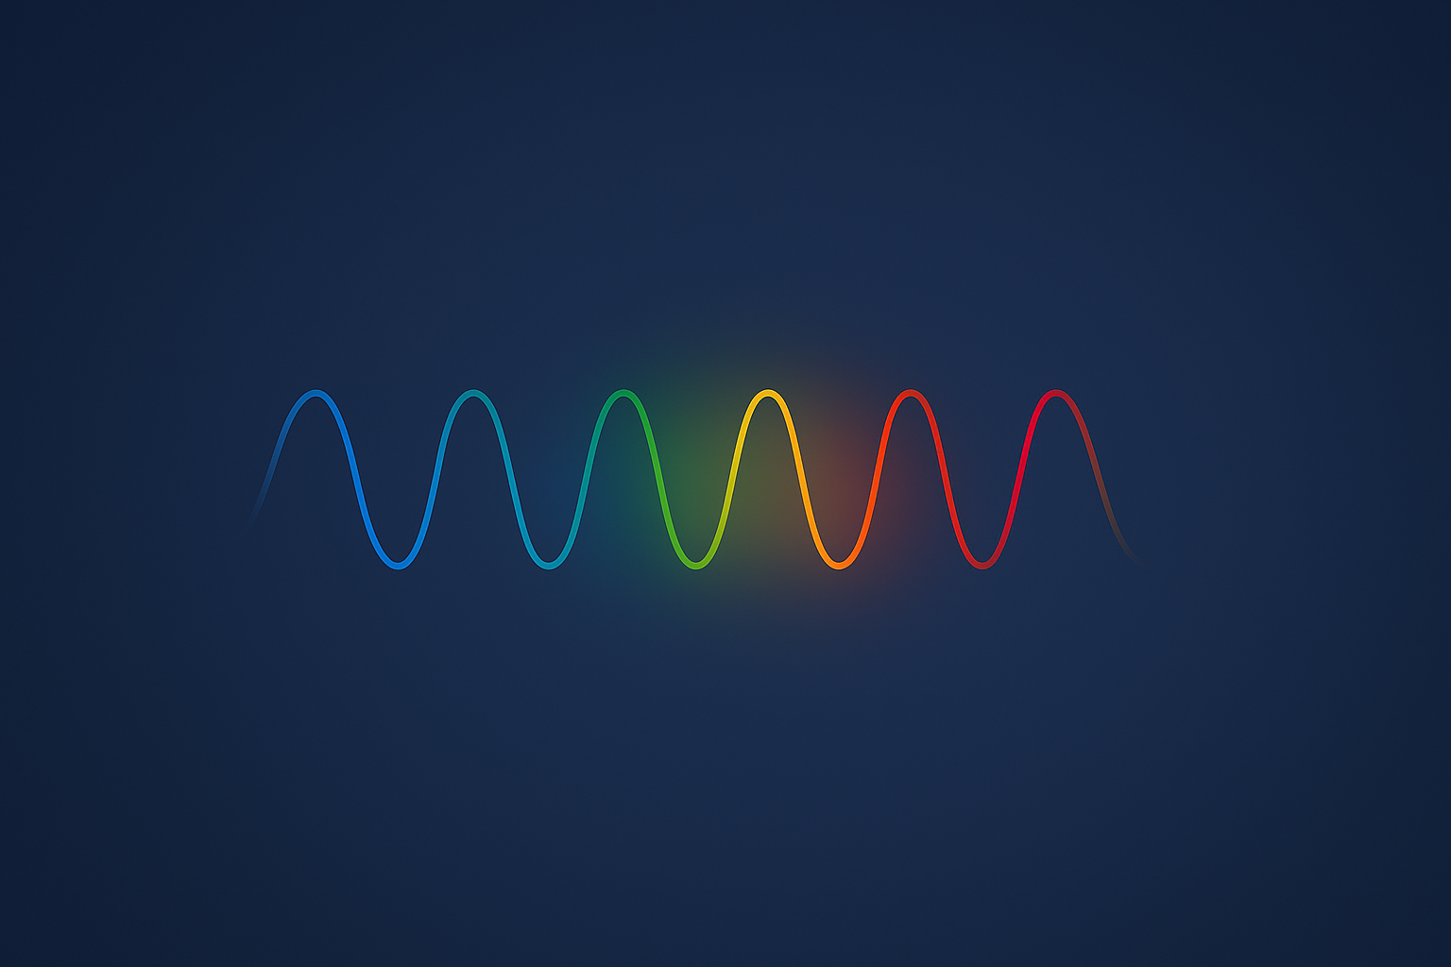
What Will We Learn?
This semester, we will learn how:
Charges interact
Fields describe forces
Changing fields create other fields
Light emerges from electromagnetism
Notes:
Electricity and magnetism explain something you experience every day: light

Slide 4
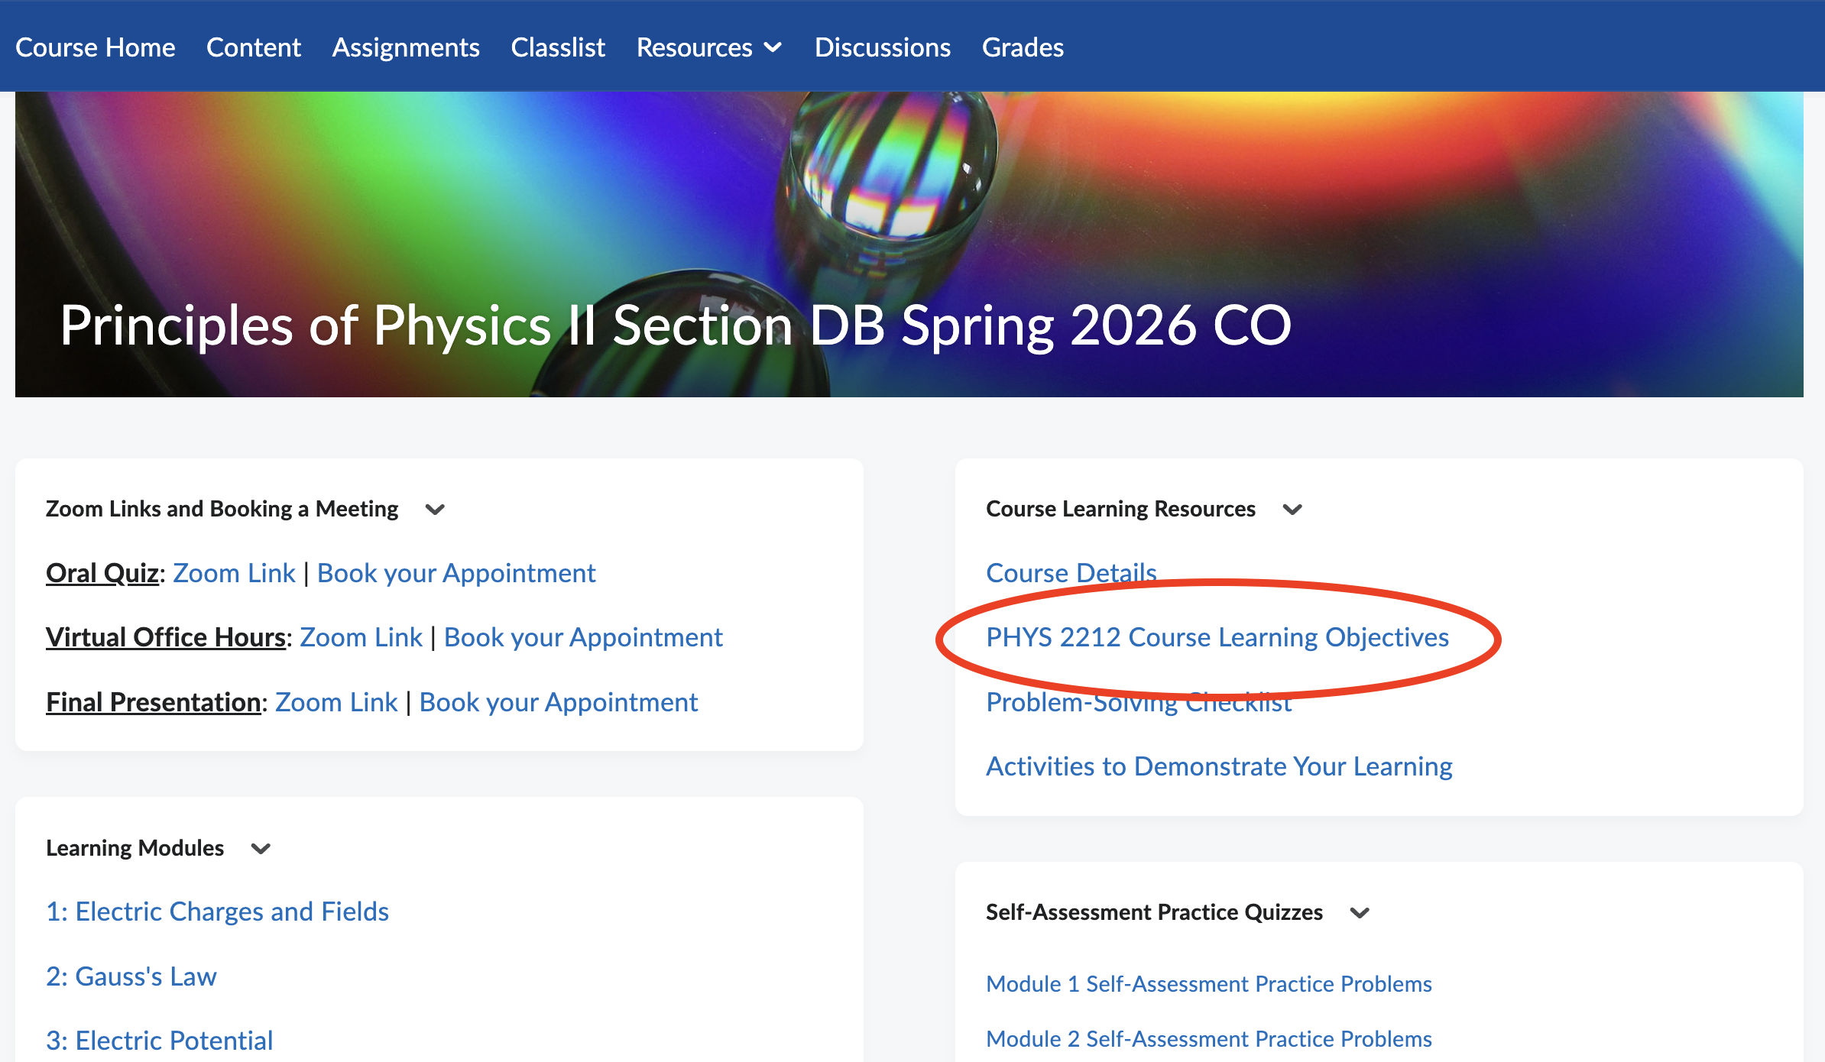

Slide 5

Why This Course Is Ungraded
Traditional grading often:
Rewards cramming over understanding
Punishes attempts, not just wrong answers
Hides misunderstanding until it's too late
This course prioritizes:
Practice
Feedback
Reflection
Mistakes aren't failures — they're information.
Notes:
Grades don’t cause learning—practice does
Mistakes are not failures; they are information

Slide 6

How Learning Is Assessed Here
You will:
Practice regularly
Reflect honestly
Revise your thinking
Demonstrate learning with your strongest evidence — not every concept, just what shows you understand
You're building evidence of learning, not chasing points.
Notes:
You are building evidence of learning, not chasing points
Everything about this course is designed to help you become a better learner, not just a better test-taker.

Slide 7
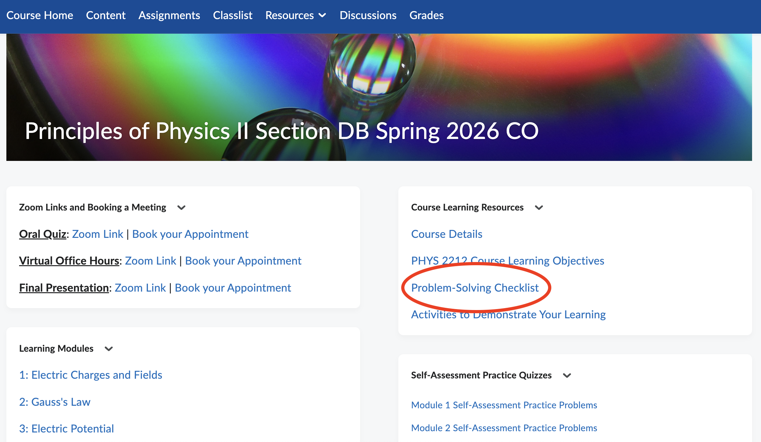

Slide 8
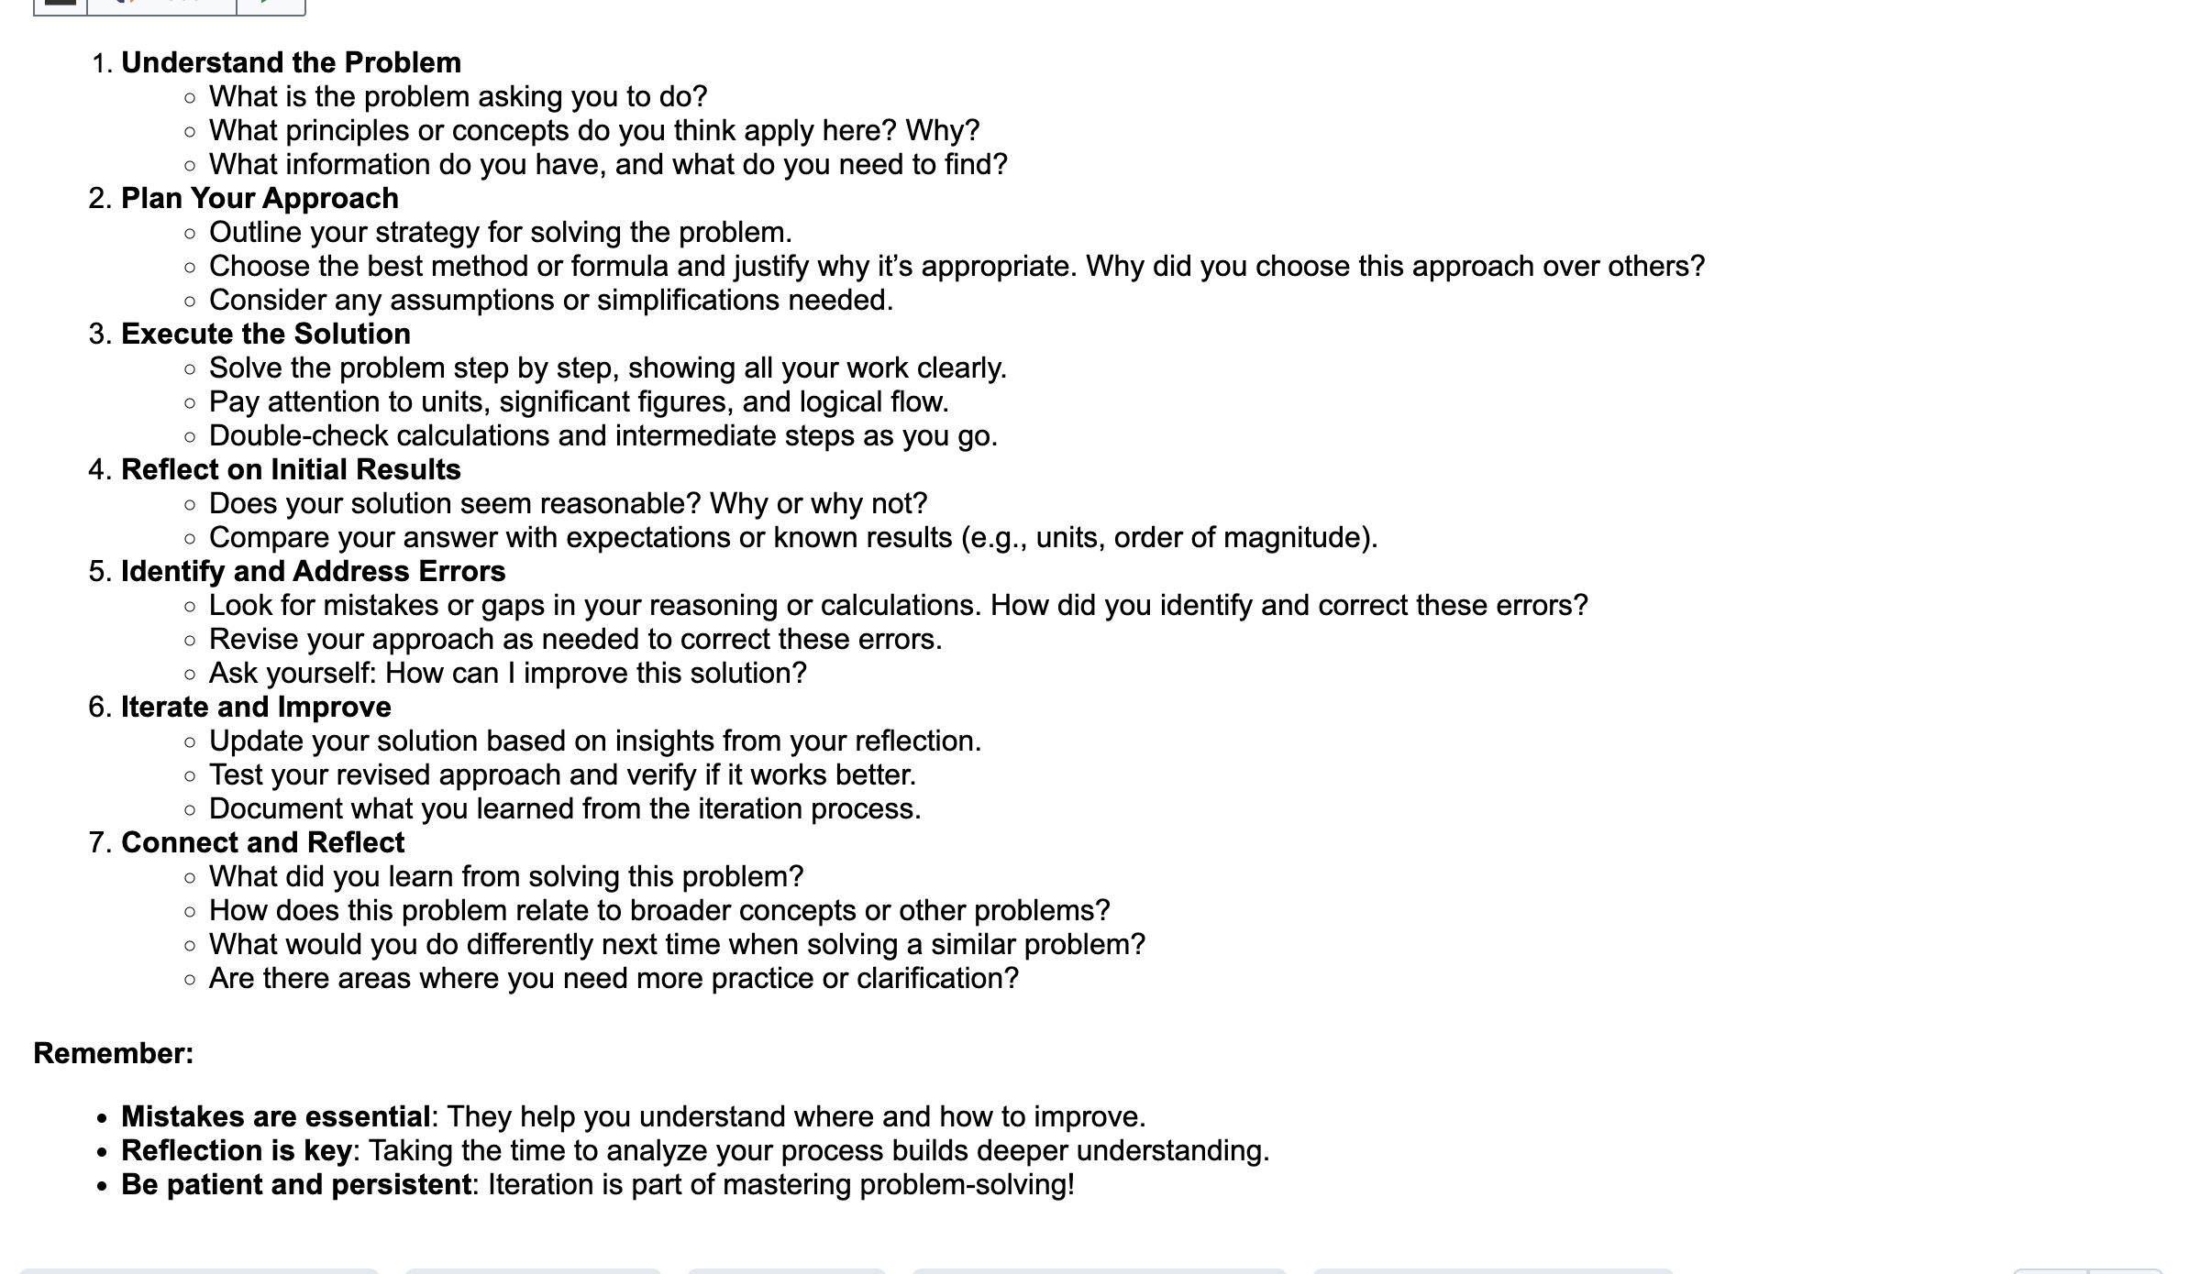

Slide 9
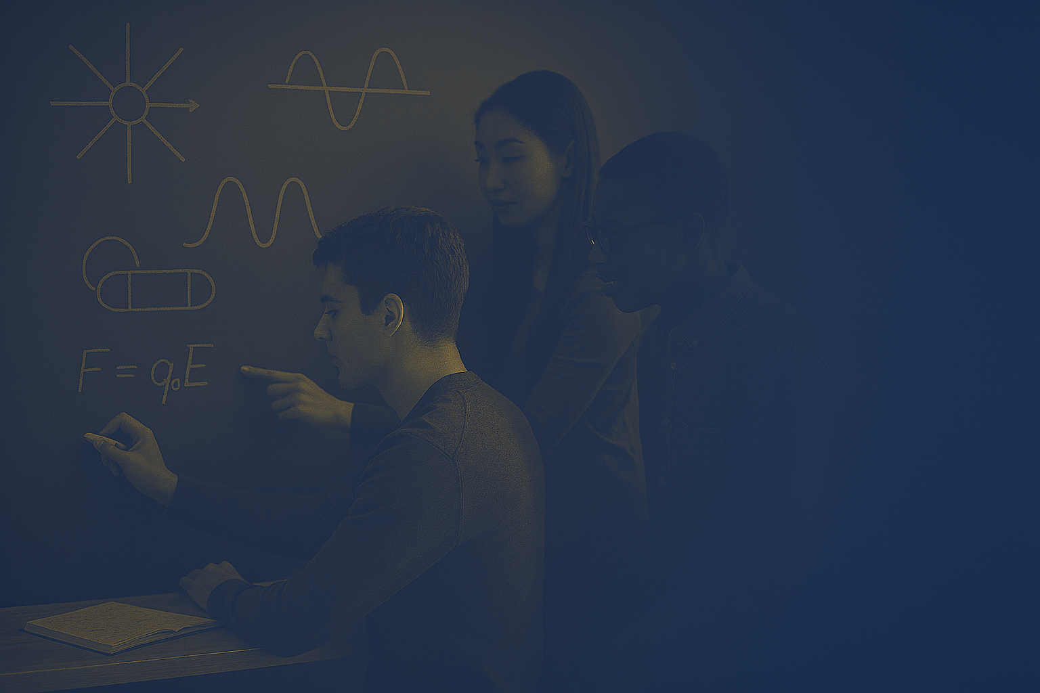
Practice → Self-Assessment → Quiz
The quiz system works like this:
Practice problems
Self-assessment & reflection
One problem selected as your quiz
No surprises. Preparation matters more than speed.
Notes:
No surprise quizzes
Preparation matters more than speed

Slide 10
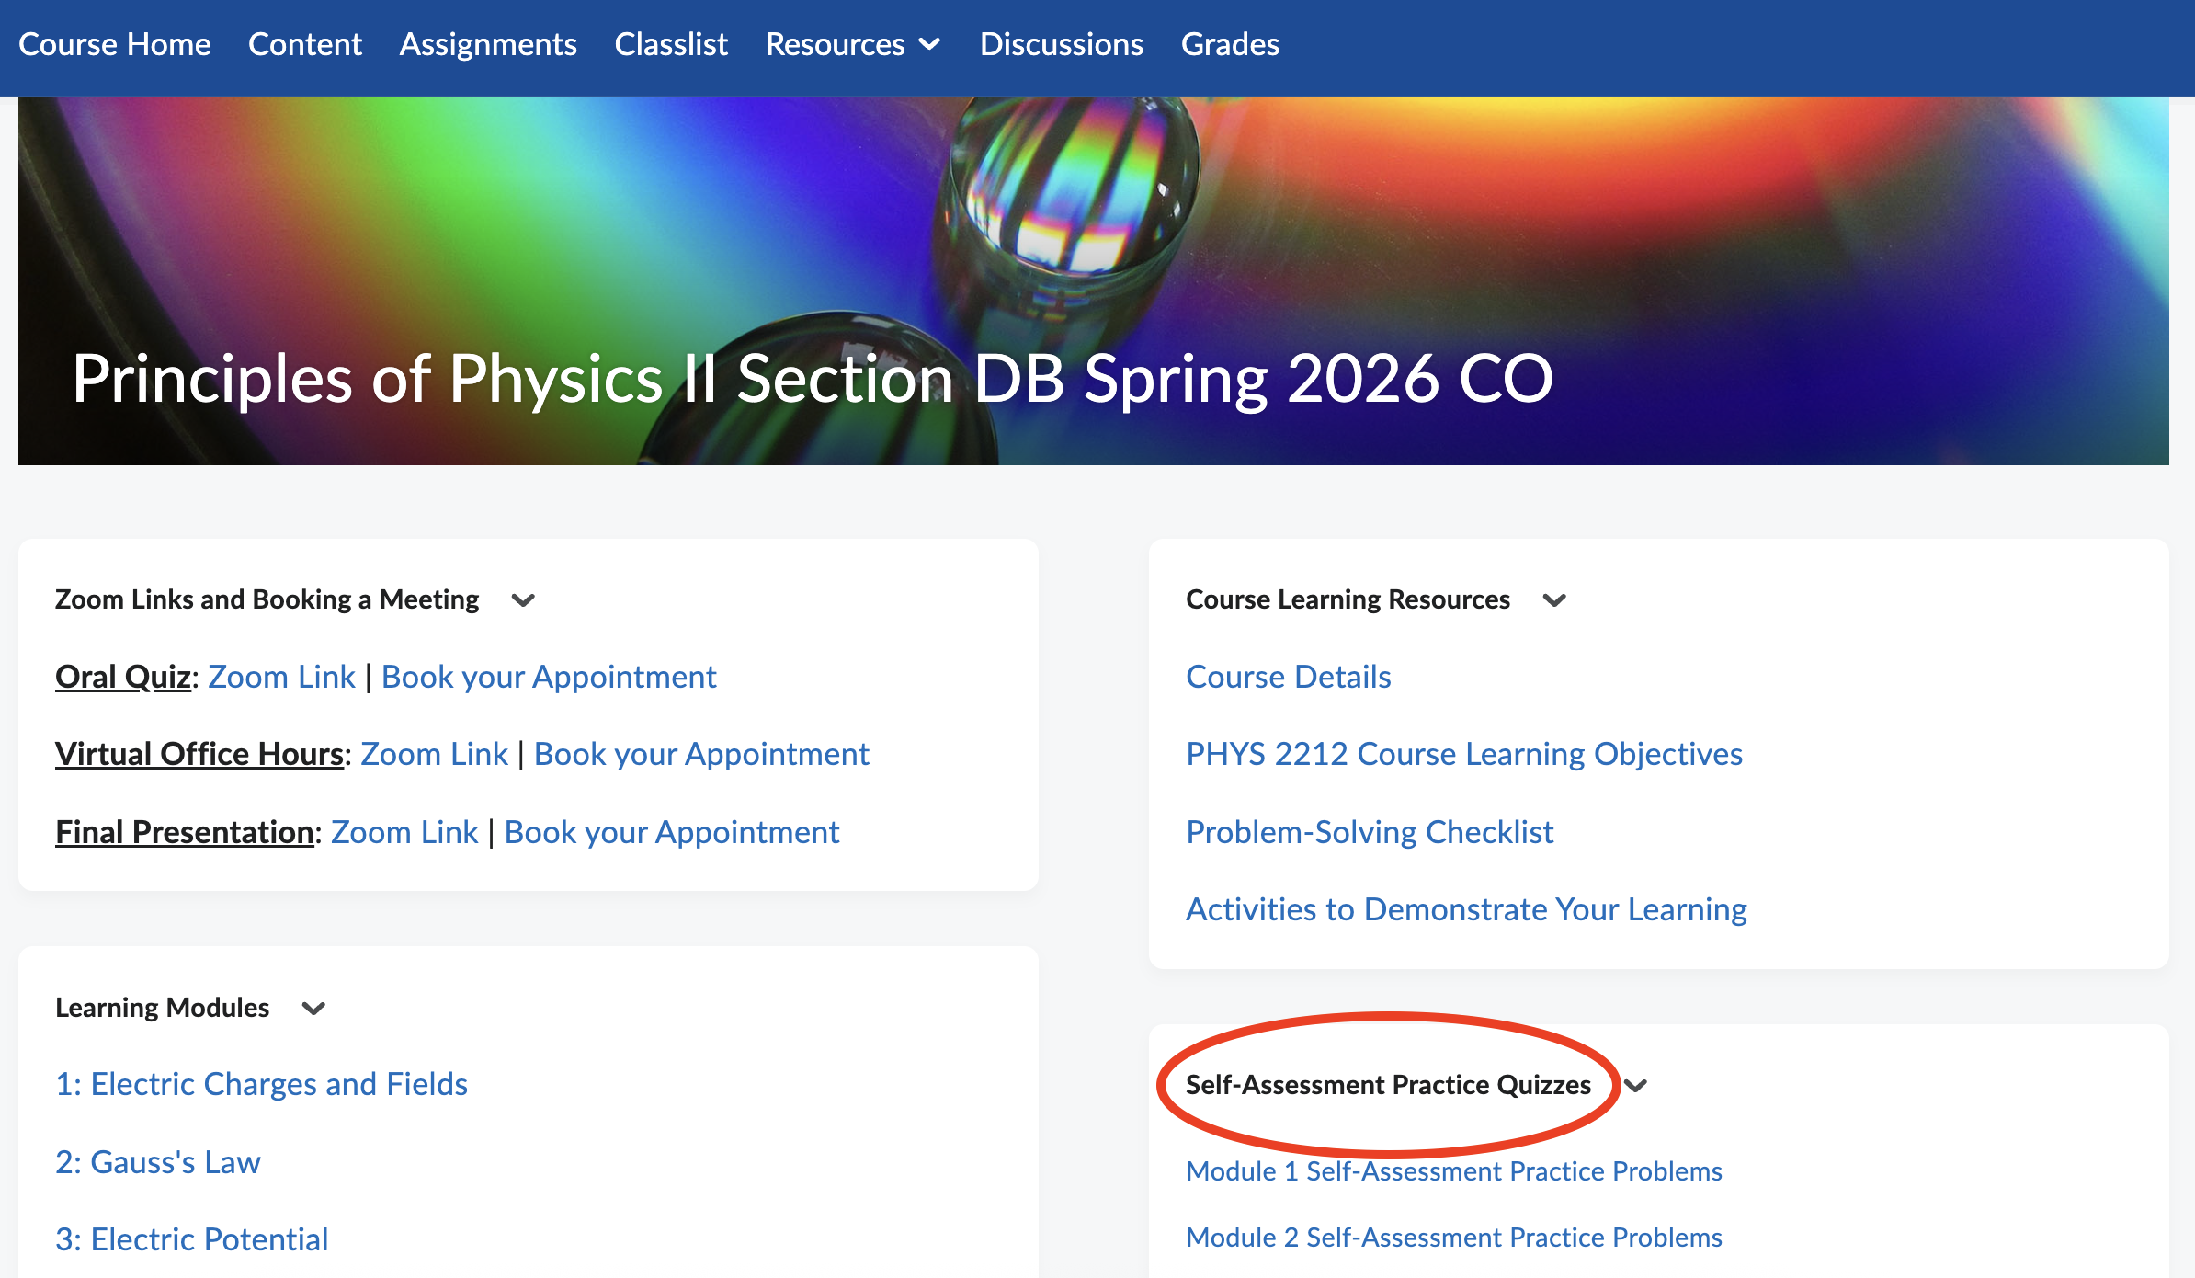

Slide 11
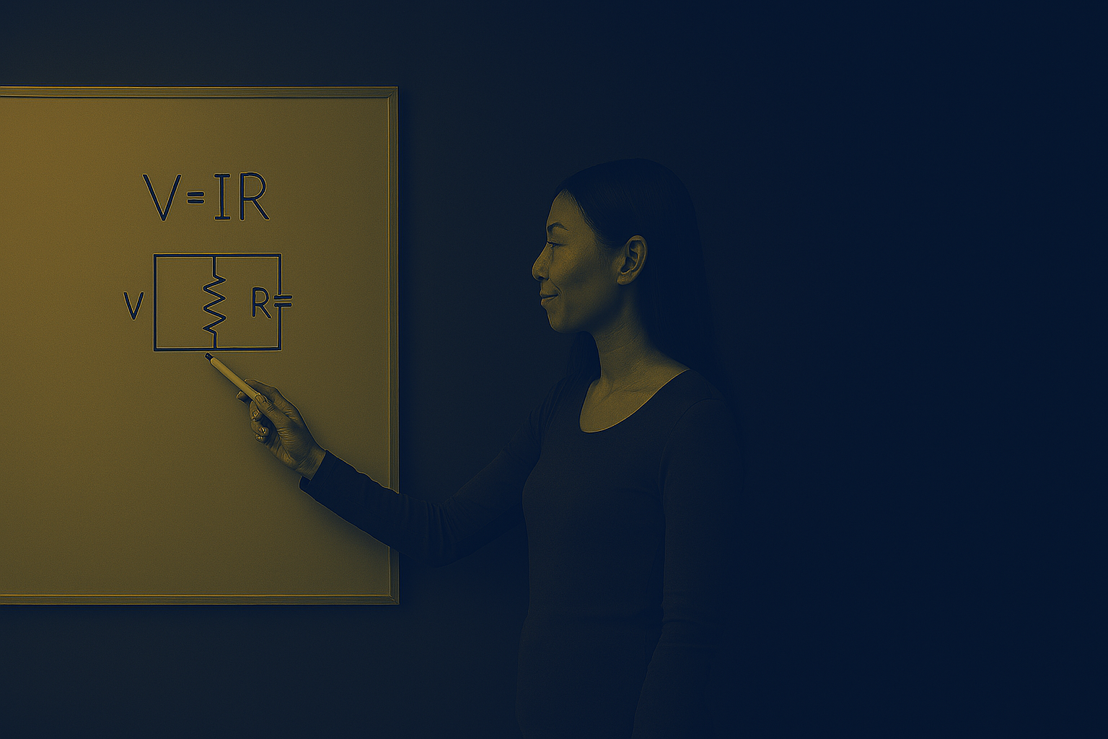
Two Quiz Formats
Written Quizzes (Fridays, in class)
One problem
Clear reasoning matters
Oral Quizzes (Zoom)
One-on-one
Scheduled via D2L
Conversational, supportive
Talking through physics is a real skill — oral quizzes give me another way to see how you're thinking.
Notes:
Oral quizzes let me see how you think
Talking through physics is a real skill

Slide 12
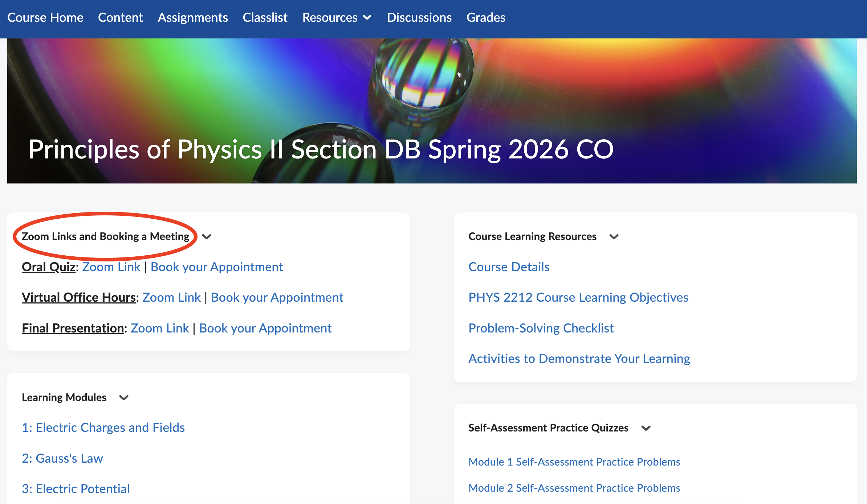

Slide 13
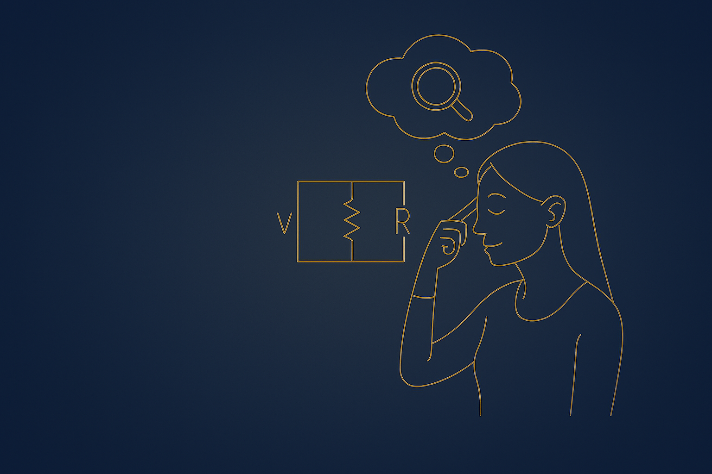
Final Grade Proposal
At the end of the semester:
You will propose your final grade
Your proposal must include evidence
Evidence is tied to course learning objectives — your strongest examples, not every concept
The goal is ownership of your learning.
Notes:
We’ll return to this later
The goal is ownership of learning

Slide 15

Attendance & Exit Tickets
Attendance matters because learning happens in class.
Exit Tickets:
Completed at the end of class
Password given in class
Due by midnight
Notes:
Exit Tickets help you consolidate learning
They help me adjust instruction

Slide 16
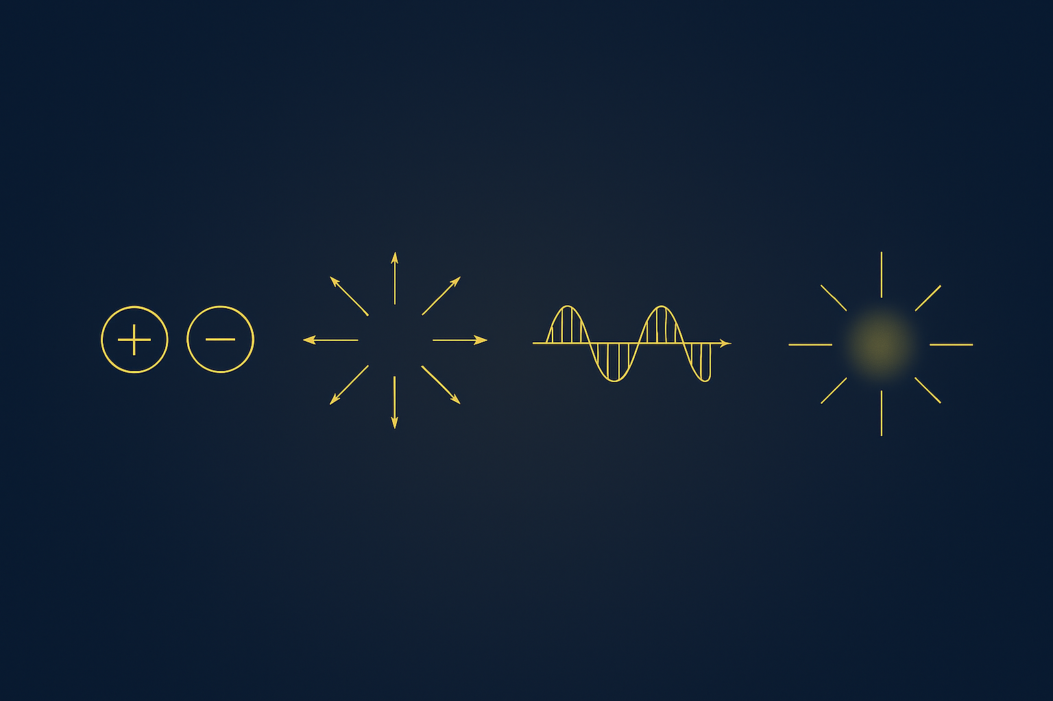
Where We’re Headed
Electric charge …. Fields …. EM Waves … Light

Slide 17
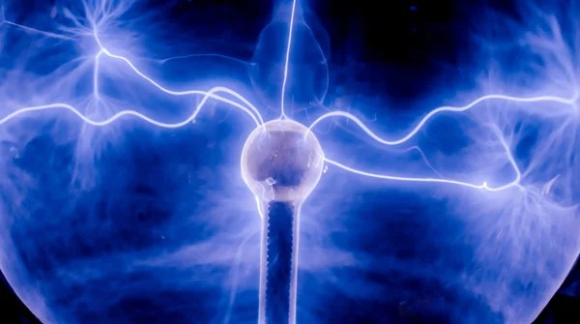
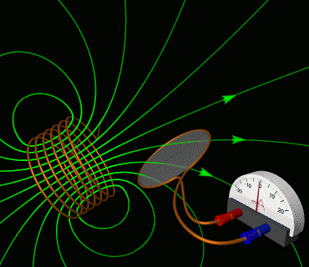
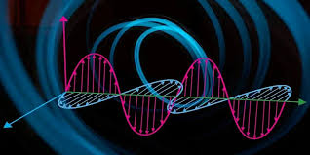
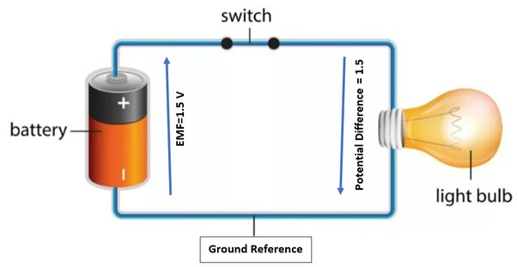
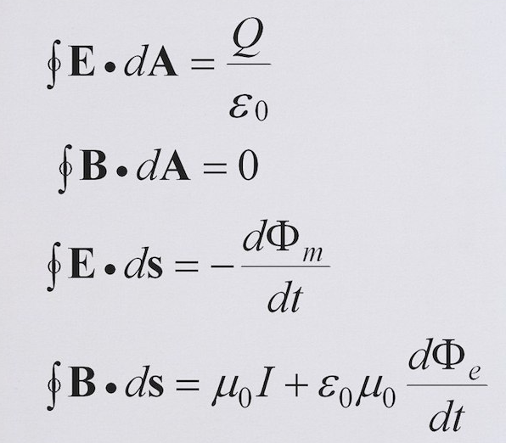
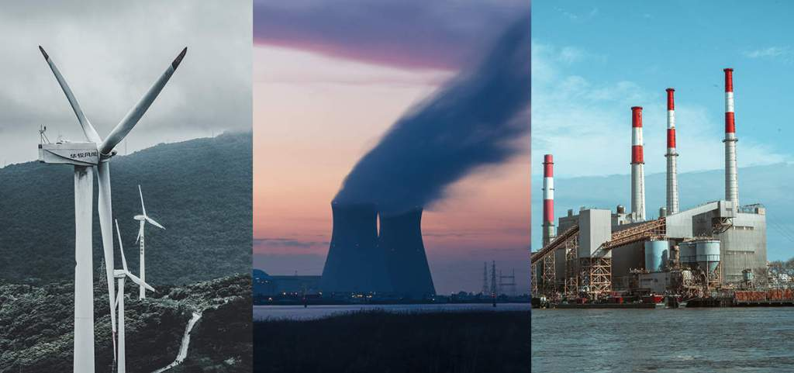
Four Units, One Story
Charges & Fields
Circuits
Magnetism & Induction
Waves & Light
Vector calculus is the language we use throughout.
Every unit connects to real technology — power grids, MRI, your phone.

Slide 18
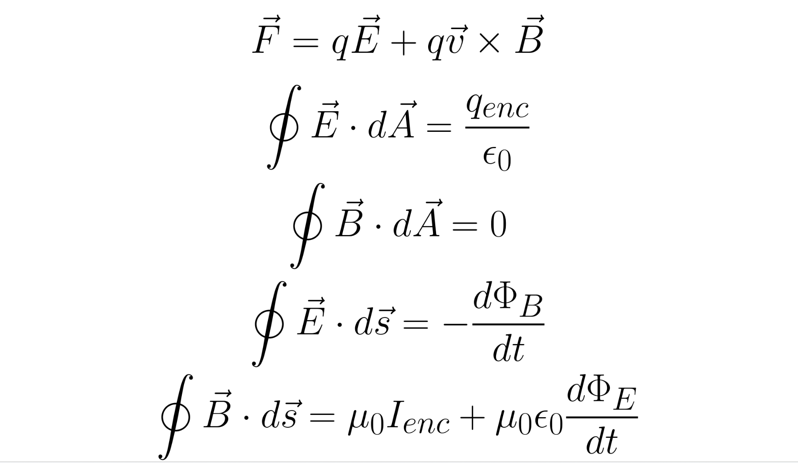

Slide 19
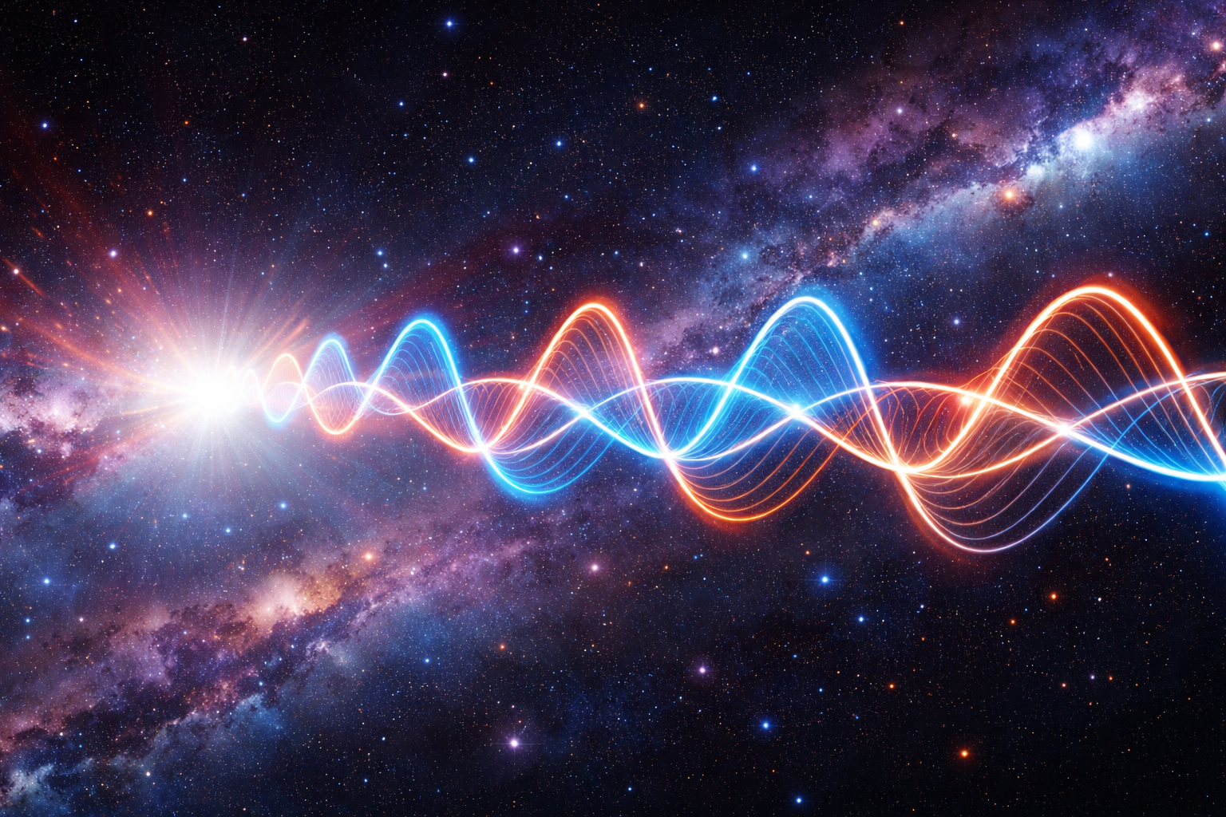
The Big Idea
Simple rules → profound consequences
Like charges repel, unlike charges attract → Fields evolve → Light propagates

Slide 20
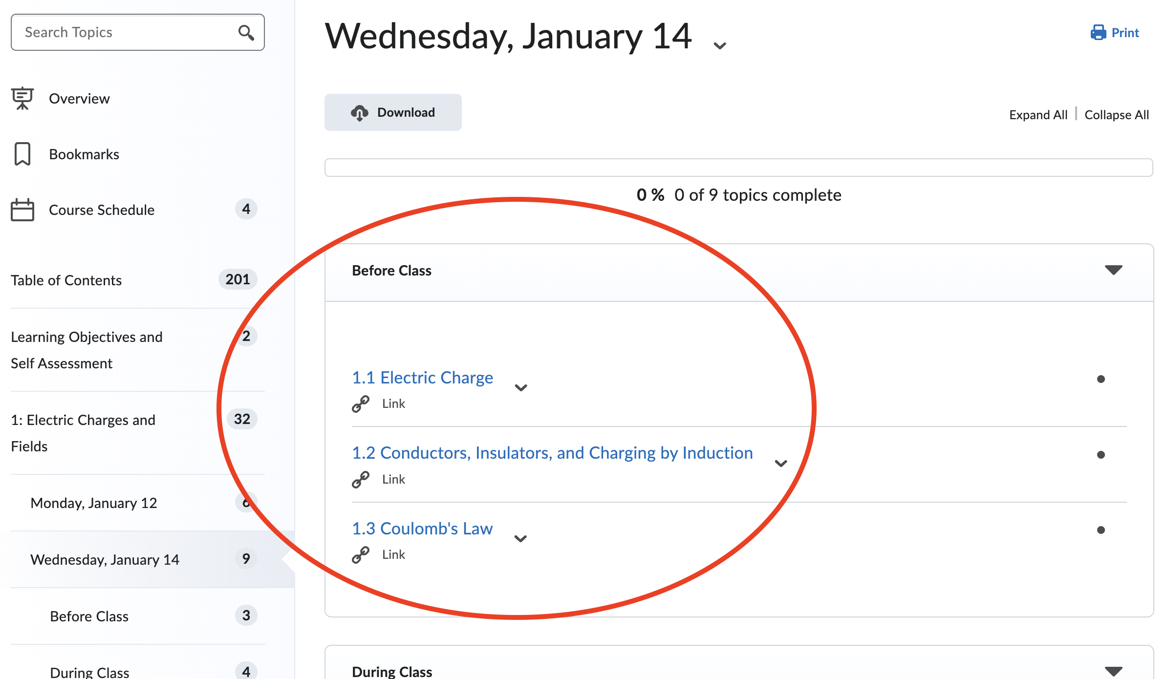

Slide 21

Exit Ticket
Before you leave:
One thing you’re unsure/curious about
One thing that feels new or unexpected

Slide 22
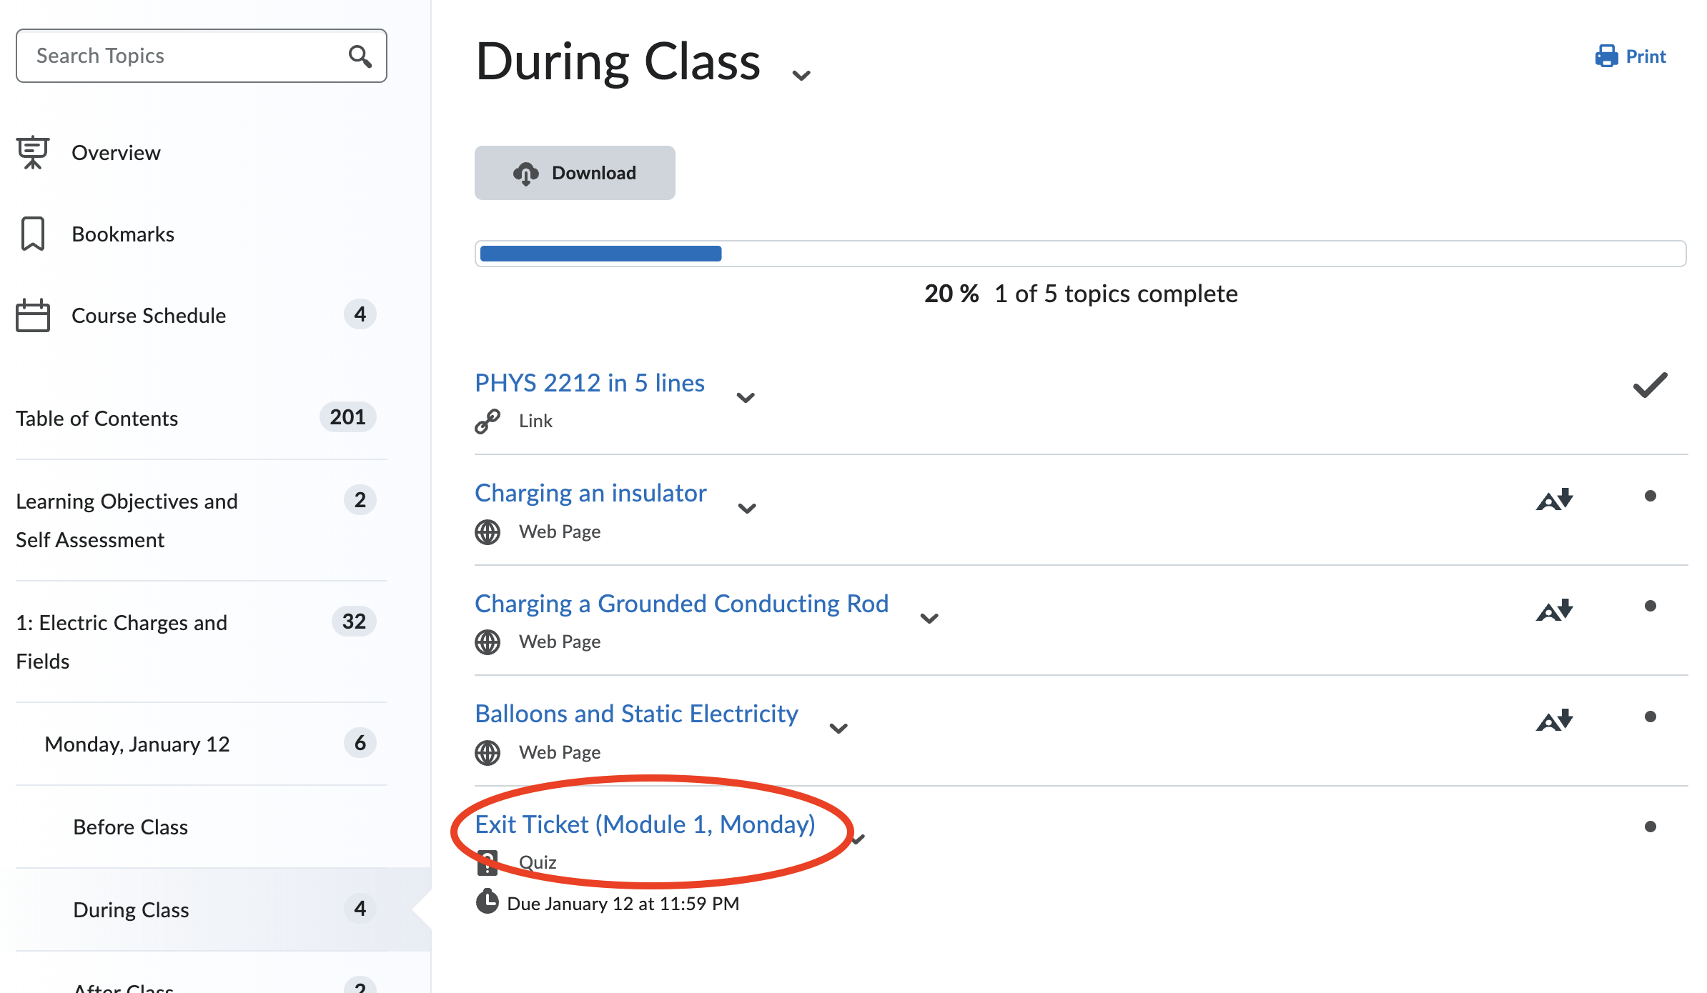
k5Fp9RjZ

